Slide 1
6221 tutor2
yyyy

Slide 2
quiz
Last Year:
7 true/false questions (10 marks per question)
1 multiple choice question (30 marks)
Total: 100 marks. 15% of your final score
Please note that all questions require a brief explanation of the reasoning.
Notes:
分abc卷

Slide 3
For reference only
Can 8 points be used to obtain an essential matrix?
Can 4 coplanar points be used to obtain a Homography matrix?
Can both Essential matrix (E) and Homography matrix (H) be used to obtain R and a scaled translation x?
Precision describes the difference between the measurement and true value, while accuracy relates to reproducibility of sensor results.
Is Kalman filtering statistically optimal for linear systems?
If two random variables, X and Y, are (uncorrelated) independent, the variance of their sum equal to the sum of their individual variances.
Structure from Motion (SFM) is the study of the rotation and translation that separates these two camera views and the relative structure of the observed feature points

Slide 4

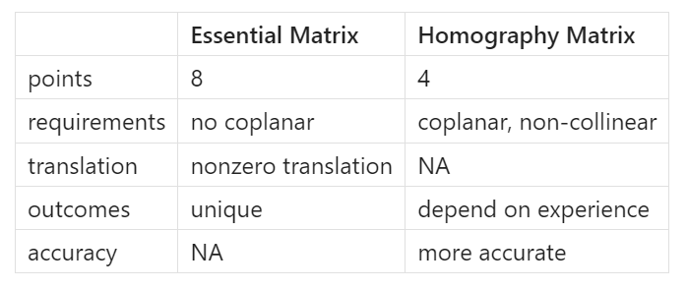
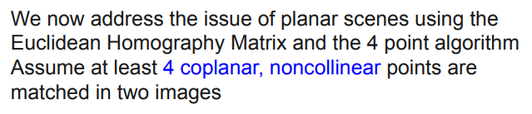
Question answer
Can 8 points be used to obtain an essential matrix?
Can 4 coplanar points be used to obtain a Homography matrix?
Can both Essential matrix (E) and Homography matrix (H) be used to obtain R and a scaled translation x?

Slide 5
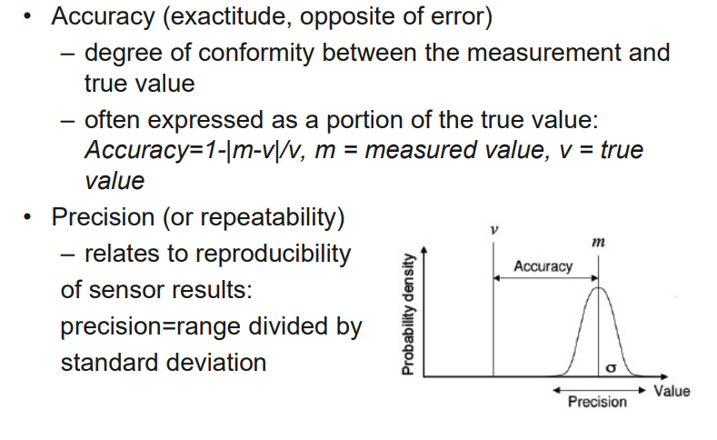
Question answer
4. Precision describes the difference between the measurement and true value, while Accuracy relates to reproducibility of sensor results
Lec1，page24
Notes:
准确率Precision
精确率Accuracy

Slide 6
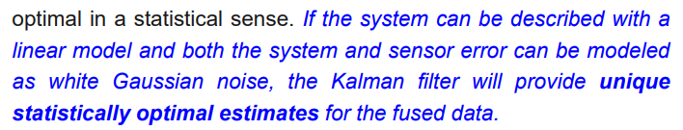
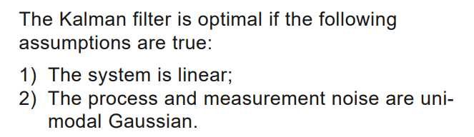
Question answer
5. Is Kalman filtering statistically optimal for linear systems?
Lec4，page17
Lec4，page45
Notes:
线性条件，高斯白噪声
统计最优解

Slide 7
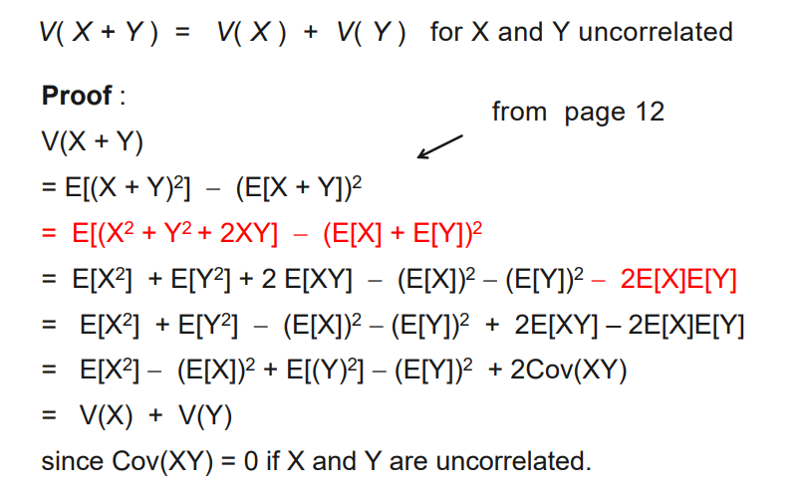
Question answer
6. If two random variables, X and Y, are (uncorrelated) independent, the variance of their sum equal to the sum of their individual variances.
Lec4，page15

Slide 8
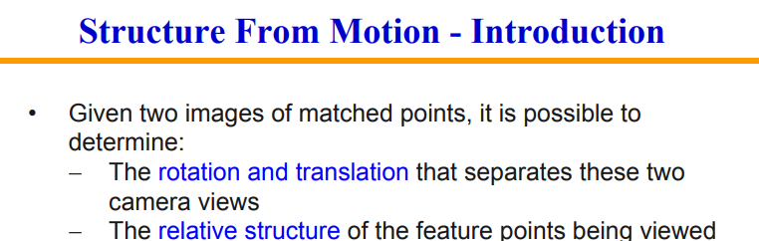
Question answer
7. Structure from Motion is the study of the rotation and translation that separates these two camera views and the relative structure of the observed feature points.
Lec3，page4

Slide 9
Multiple choice question
Which of the following are advantages of multi-sensor integration and fusion? Justify your answer in detail.
Redundancy
Accuracy
Reliability

Slide 10
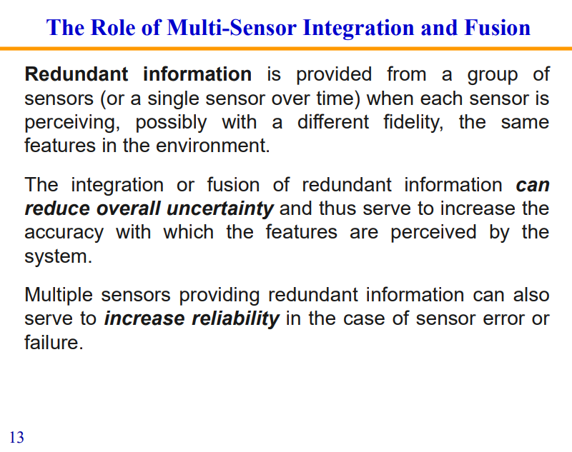
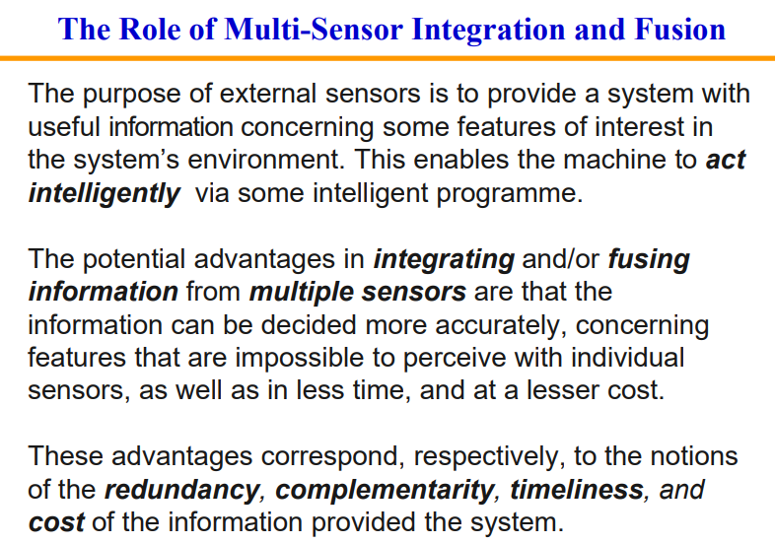
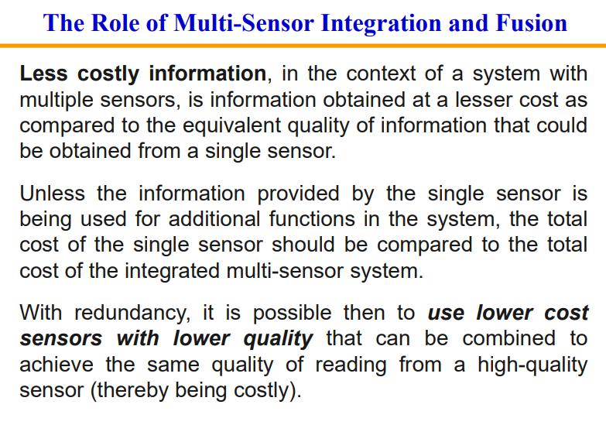
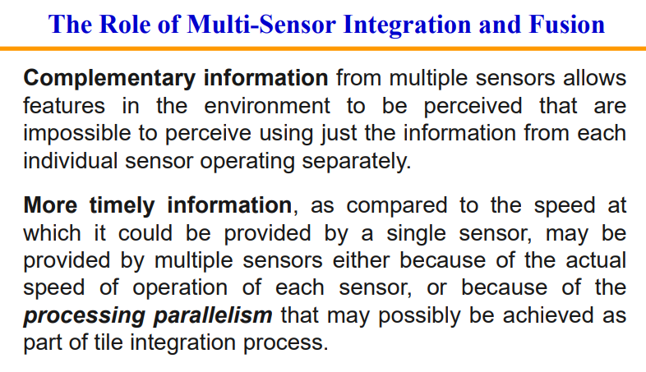
Lec1 Page12-15

Slide 11
3 Mobile Robots

Slide 12
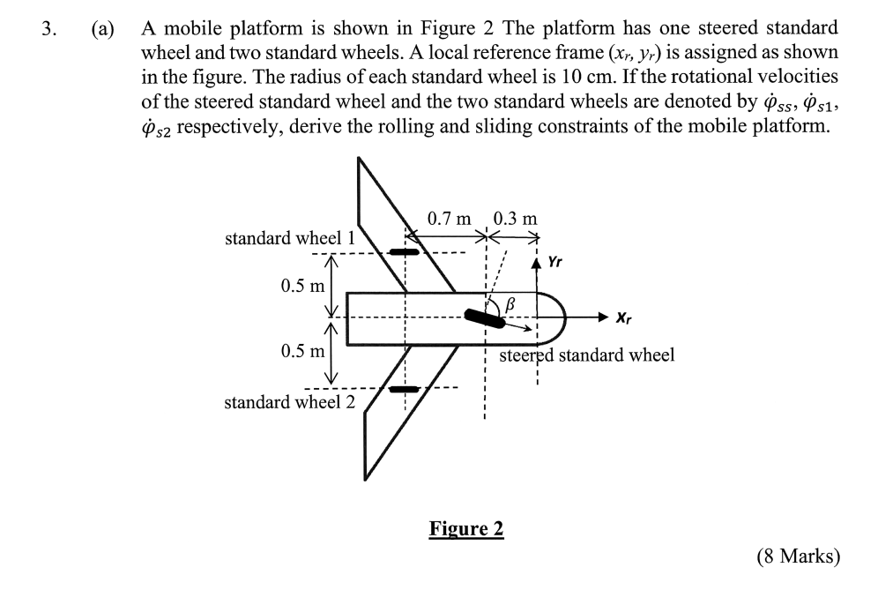
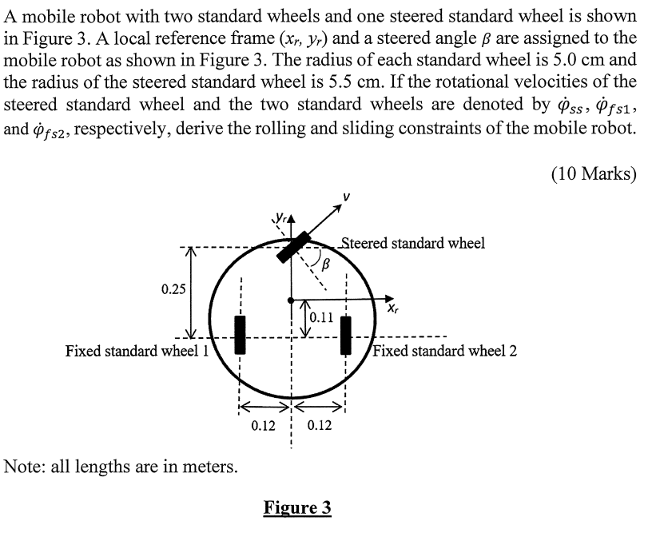

Slide 13
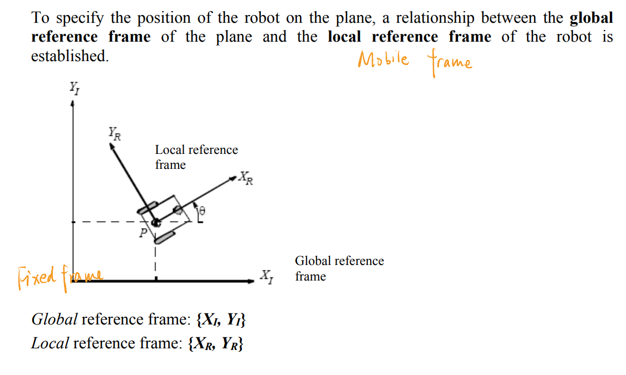
Mobile Robots

Slide 14
Basic wheel types
Standard wheel
Castor wheel
Swedish wheel
Ball or spherical wheel

Slide 15
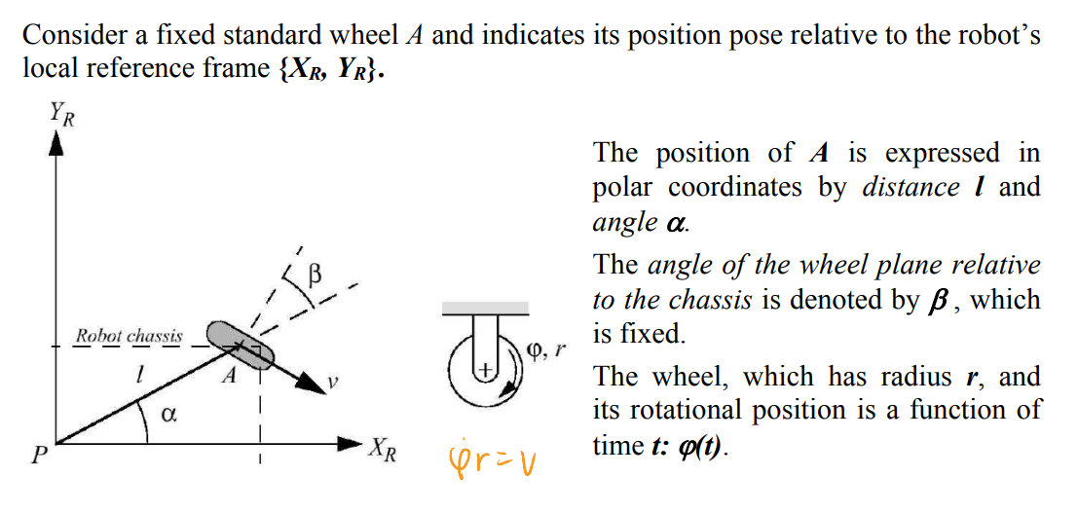
Fixed standard wheel
Notes:
固定标准轮：只能沿轮平面往复运动。
l: 轮子中点到世界坐标轴原点的距离，相当于轮子滚动半径
alpha是轮子中心到原点的连线与x轴正方向的夹角
β通过右手定则确定，是参考点P到轮轴中点A的连线和轮轴轴线（右手定则确定）的夹角，逆时针为正。

Slide 16
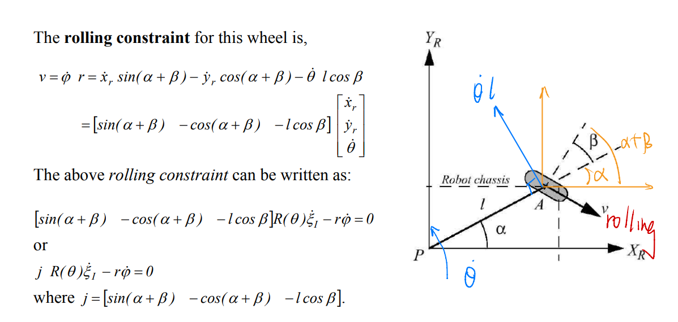
Fixed standard wheel
Notes:
标准轮的滚动约束
β通过右手定则确定，是参考点P到轮轴中点A的连线和轮轴轴线（右手定则确定）的夹角，逆时针为正。
投影法：沿着rolling方向做因式分解，x，y，theta这三个速度在滚动方向上的合成速度
Theta指的是轮子绕参考点的转动速度，角速度在轮子原点带来转动速度

Slide 17
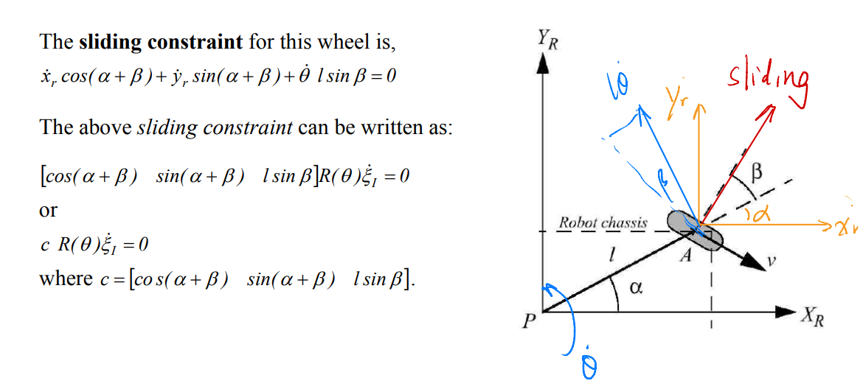
Fixed standard wheel

Slide 18


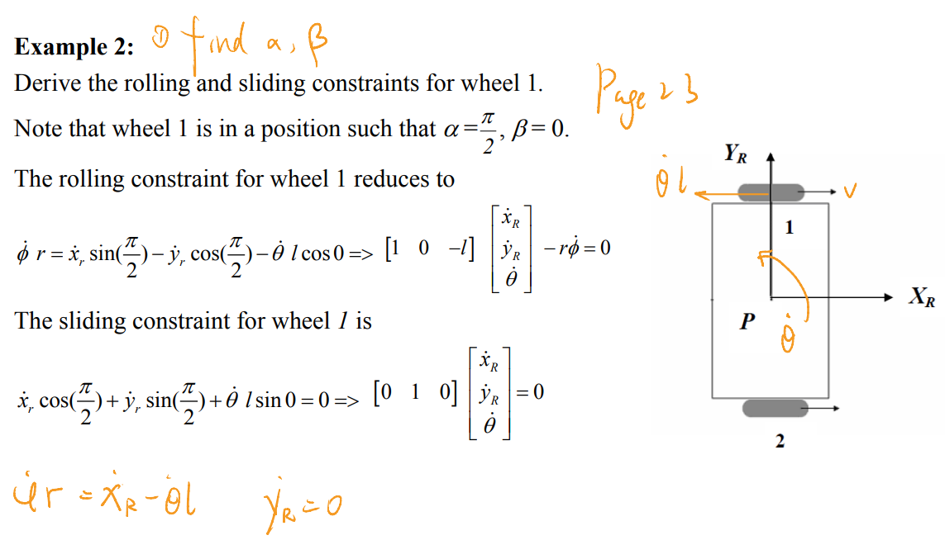
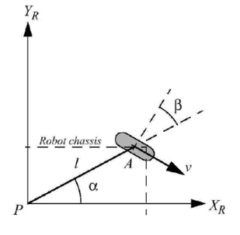
Fixed standard wheel

Slide 19
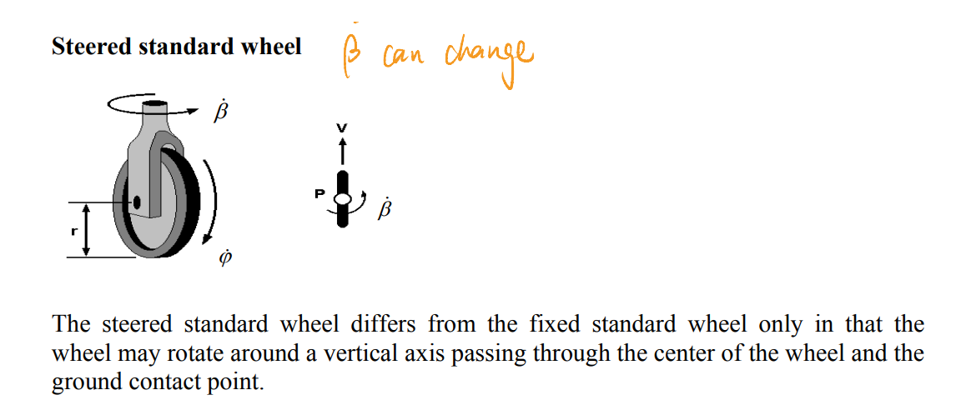
Steered standard wheel
Notes:
转向标准轮

Slide 20
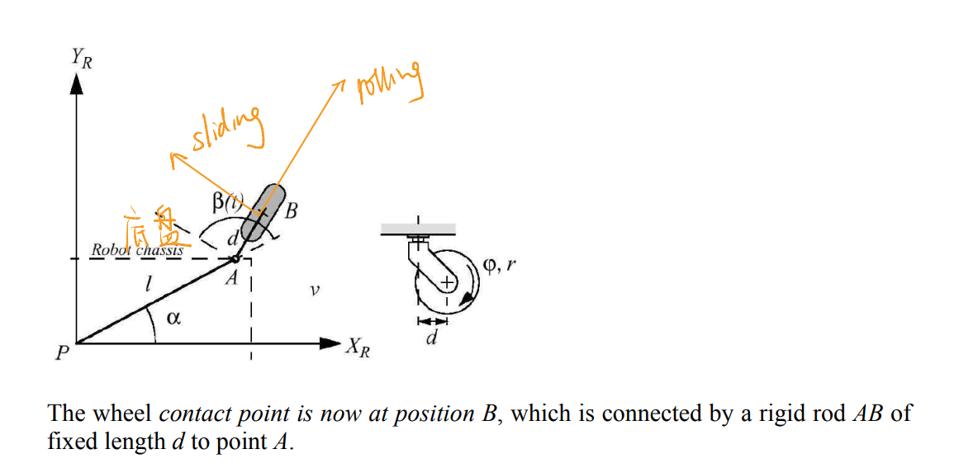
Castor wheel
Notes:
脚轮

Slide 21
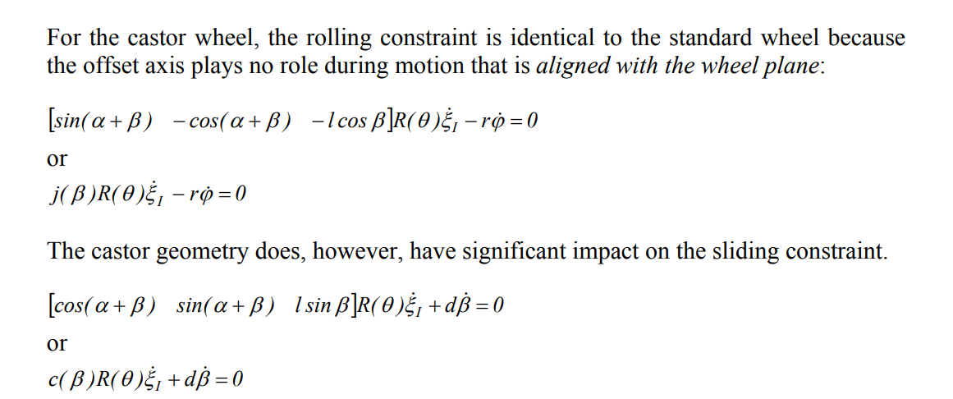
Castor wheel
Notes:
脚轮

Slide 22
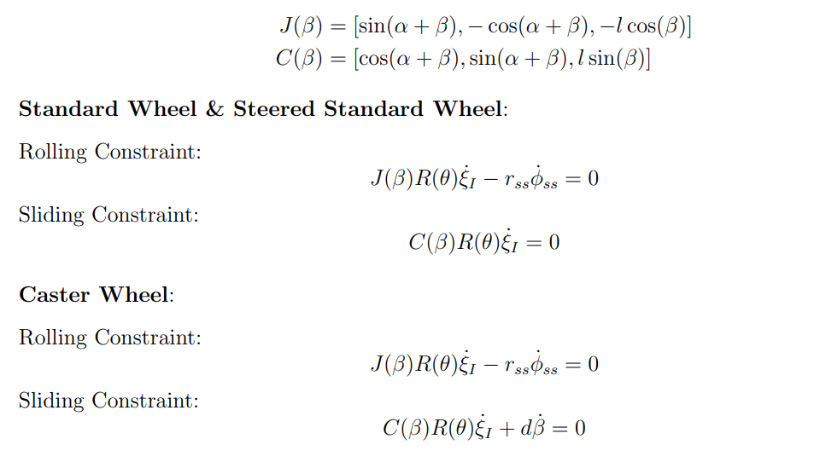
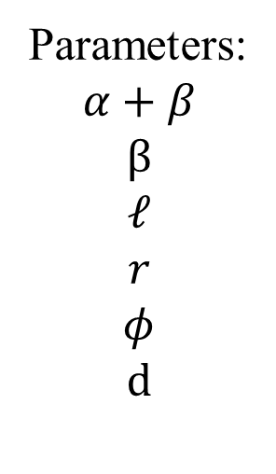
Formula
Parameters:
$$α+β$$
$$β$$
$$𝓁$$
$$r$$
$$φ$$
$$d$$
Notes:
前三个待求，后三个已知

Slide 23
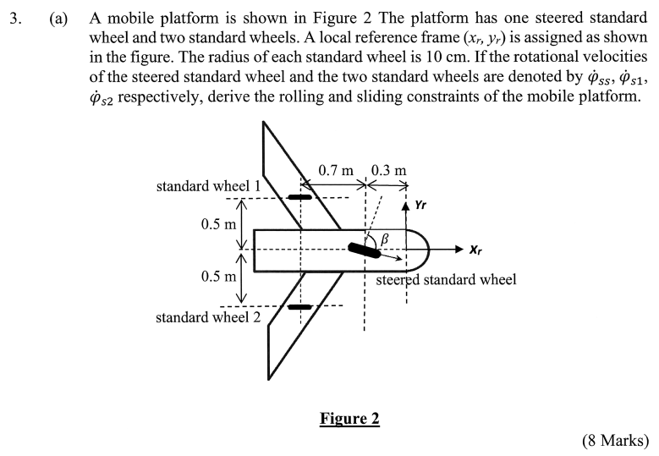
24-25 S1 Q3
Notes:
两种方法。公式和投影

Slide 24
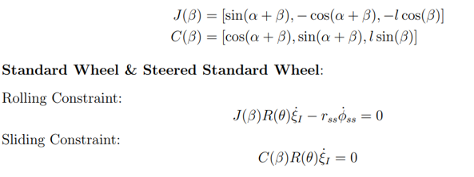
24-25 S1 Q3

Slide 25
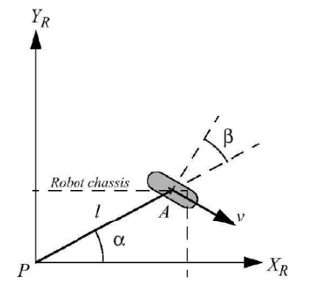

Standard wheel 1
$$α ≈153$$
$$β≈−63$$

Slide 26

Standard wheel 2
$$α ≈−153$$
$$β≈−117$$
Notes:
先判断移动方向，得到轮子的滚动和滑动坐标轴
蓝色线是世界坐标原点和轮子中心的连线
橙色是轮子的滑动方向
注意方向问题

Slide 27

Steered standard wheel
$$α ≈180$$
$$β’≈β−180$$

Slide 28
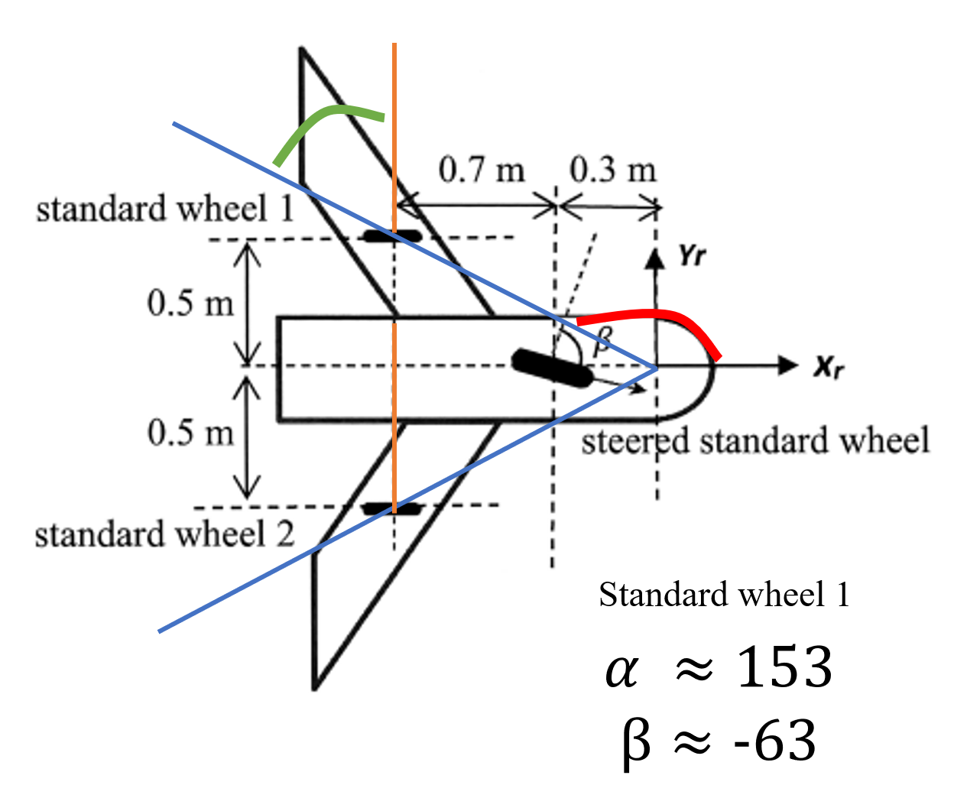
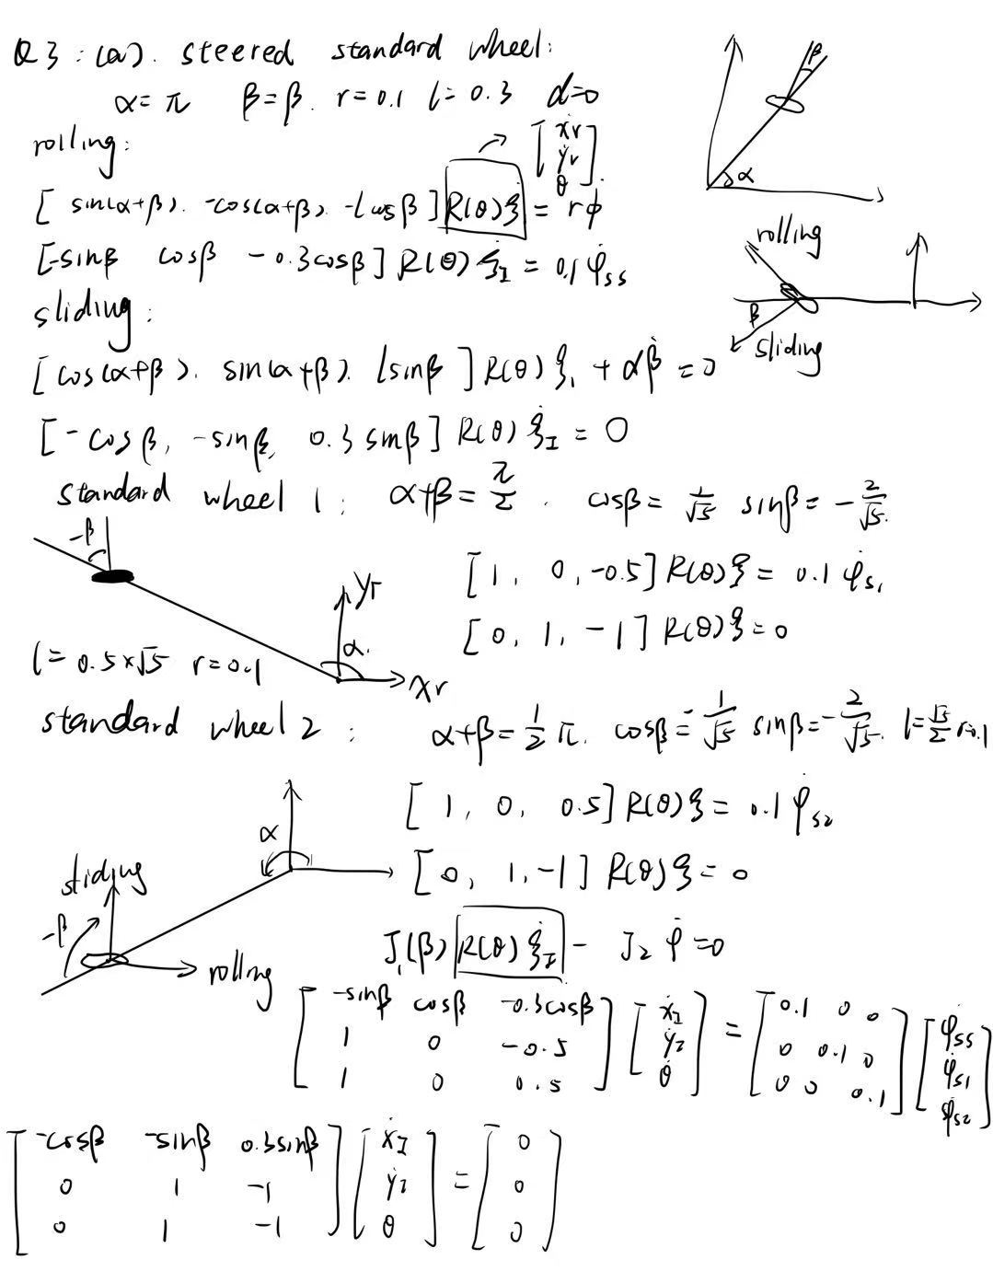

Slide 29
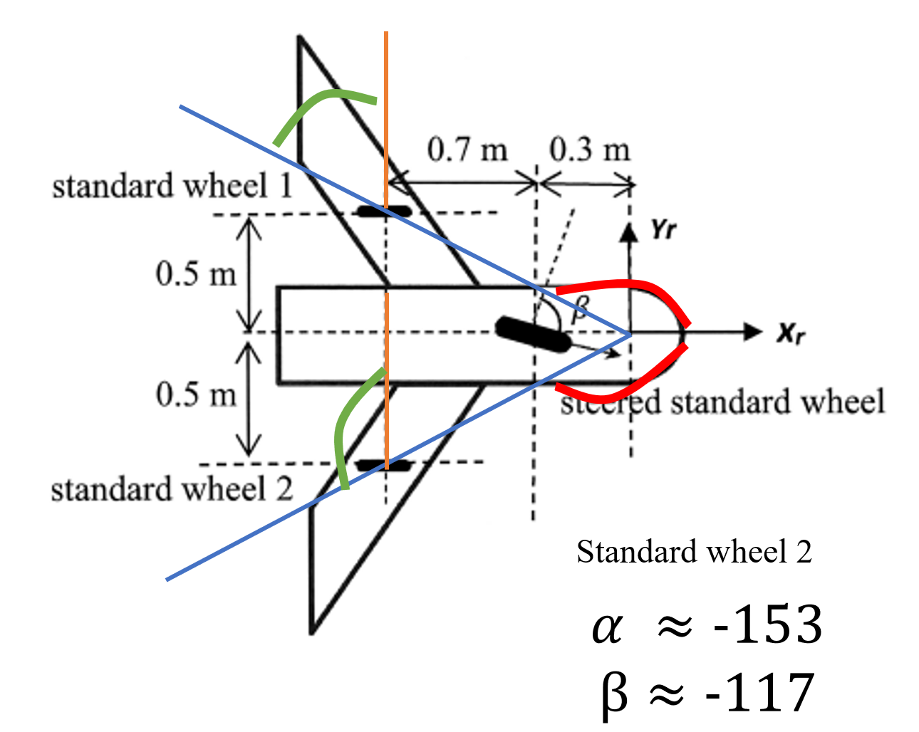

Slide 30
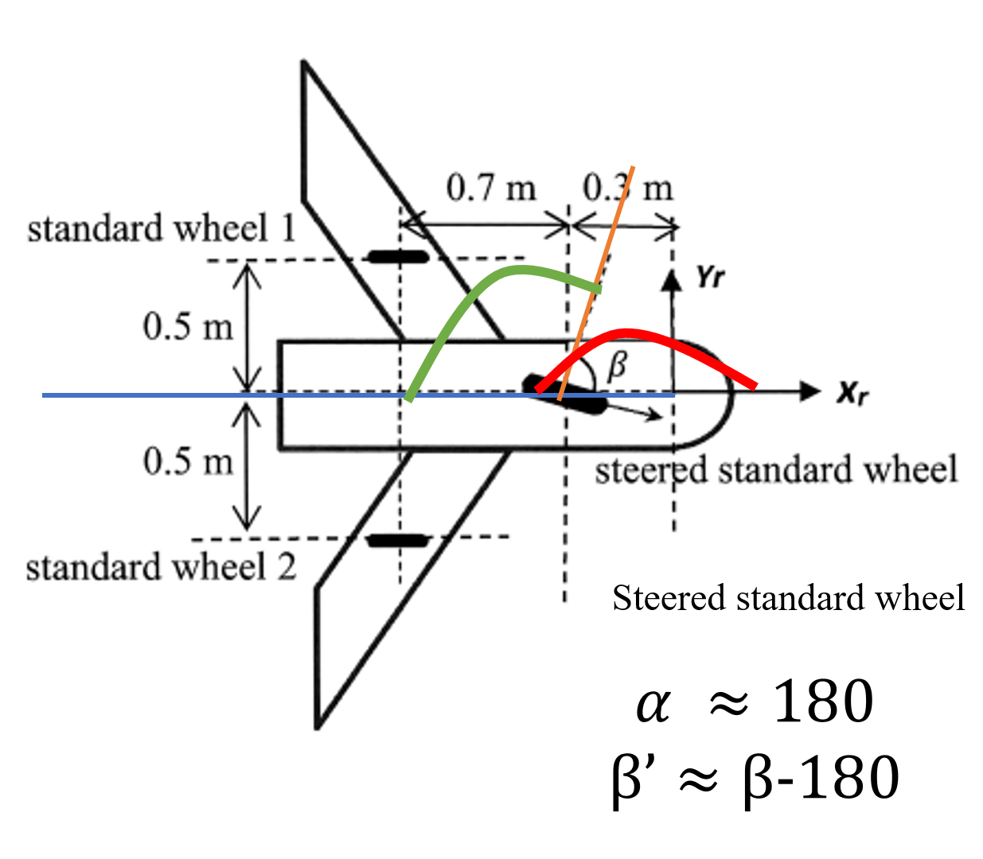
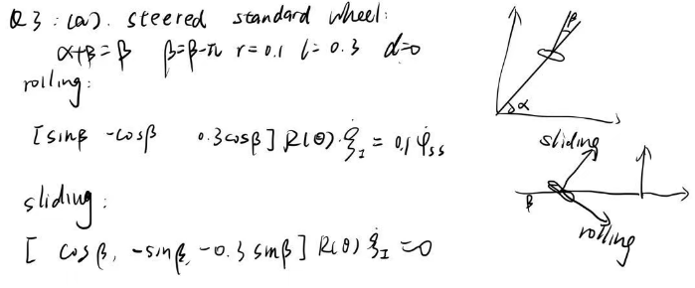


Slide 31
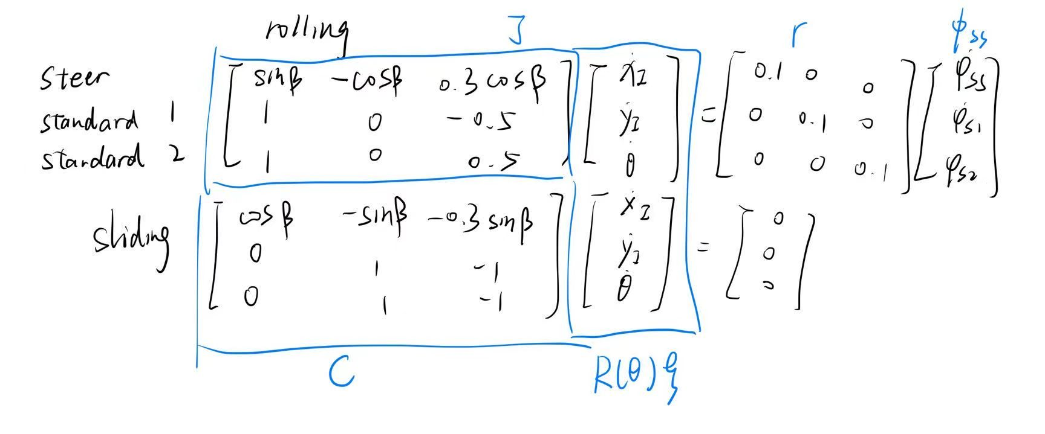
Steered standard wheel
Standard wheel 1
Standard wheel 2

Slide 32
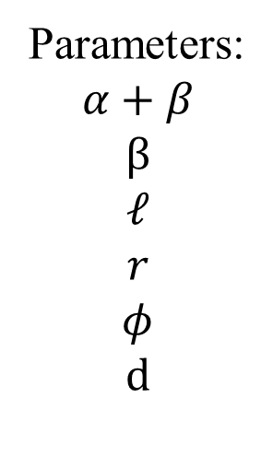
Parameters:
$$α+β$$
$$β$$
$$𝓁$$
$$r$$
$$φ$$
$$d$$

Slide 33
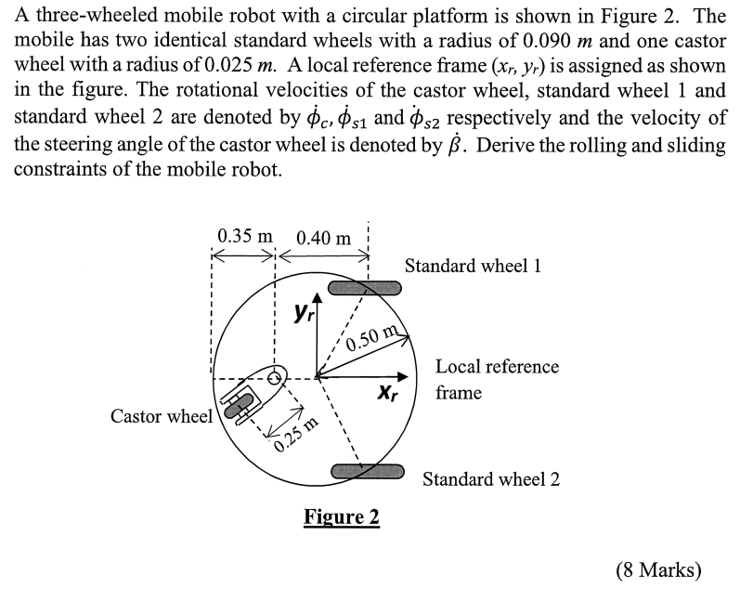
24-25 S2 Q3

Slide 34
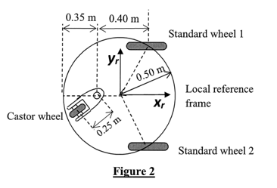
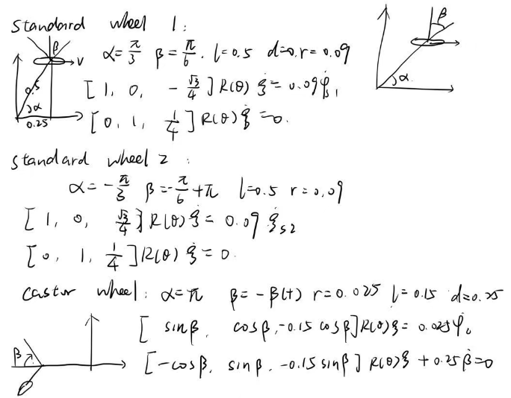

Slide 35
Kalman Filter

Slide 36
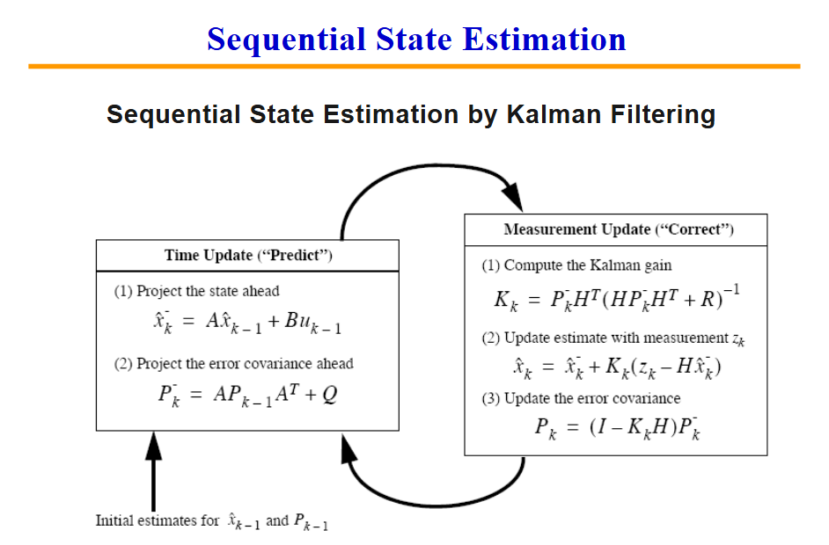

Slide 37
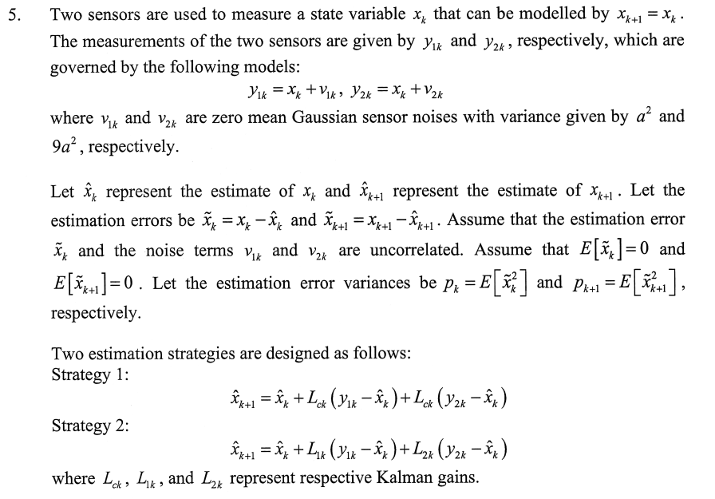
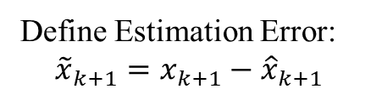
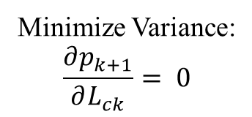
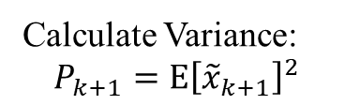
Define Estimation Error:
$${\tilde{x}}_{k+1}=x_{k+1}−{\hat{x}}_{k+1}$$
Calculate Variance:
$$P_{k+1}=E{\left[{\tilde{x}}_{k+1}\right]}^{2}$$
Minimize Variance:
$$\frac{∂p_{k+1}}{∂L_{ck}}= 0$$

Slide 38
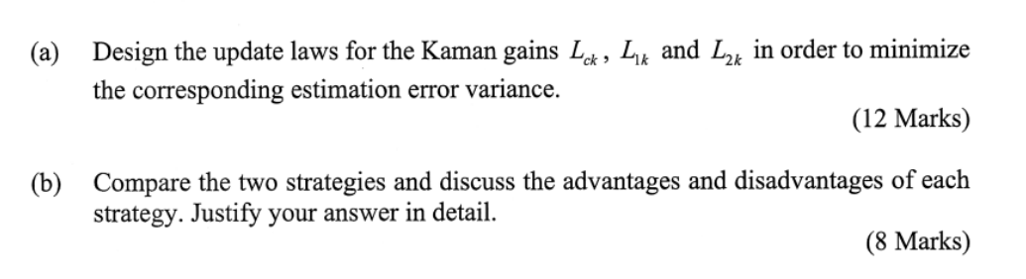
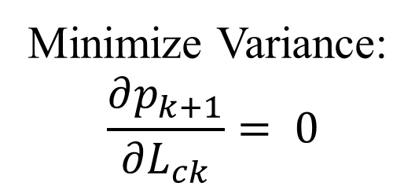
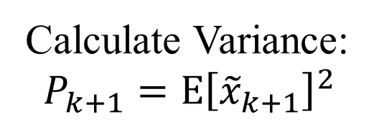
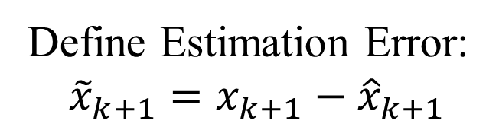
Define Estimation Error:
$${\tilde{x}}_{k+1}=x_{k+1}−{\hat{x}}_{k+1}$$
Calculate Variance:
$$P_{k+1}=E{\left[{\tilde{x}}_{k+1}\right]}^{2}$$
Minimize Variance:
$$\frac{∂p_{k+1}}{∂L_{ck}}= 0$$

Slide 39
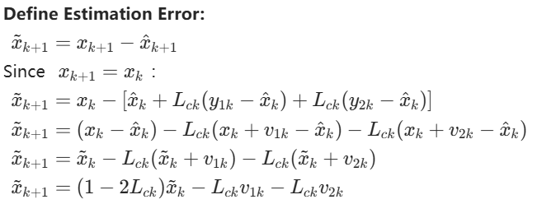
For strategy 1
Notes:
误差=测量-估计

Slide 40


Notes:
只有不相关的随机变量才可以使用
因此x_k前的系数一定要合并

Slide 41


Slide 42

For strategy 2

Slide 43


Slide 44



$$\left\{\begin{matrix}−\left(1−L_{1k}−L_{2k}\right)p_{k}+L_{1k}a^{2}=0 \\ −\left(1−L_{1k}−L_{2k}\right)p_{k}+9a^{2}L_{2k}=0\end{matrix}\right.$$

Slide 45




Slide 46



Batch Processing for each sensor VS Single Gain for each sensor
Smaller possible error variance
More computation resource
$$P_{k+1}=\frac{9a^{2}P_{k}}{10P_{k}+9a^{2}}$$
$$P_{k+1}=\frac{5a^{2}P_{k}}{2P_{k}+5a^{2}}$$
$$\frac{9a^{2}P_{k}}{10P_{k}+9a^{2}} <\frac{5a^{2}P_{k}}{2P_{k}+5a^{2}}$$

Slide 47




24-25 S2 Q5
Define Estimation Error:
$${\tilde{x}}_{k+1}=x_{k+1}−{\hat{x}}_{k+1}$$
Calculate Variance:
$$P_{k+1}=E{\left[{\tilde{x}}_{k+1}\right]}^{2}$$
Minimize Variance:
$$\frac{∂p_{k+1}}{∂L_{ck}}= 0$$

Slide 48





Minimize Variance:
$$\frac{∂p_{k+1}}{∂L_{ck}}= 0$$
Define Estimation Error:
$${\tilde{x}}_{k+1}=x_{k+1}−{\hat{x}}_{k+1}$$
Calculate Variance:
$$P_{k+1}=E{\left[{\tilde{x}}_{k+1}\right]}^{2}$$

Slide 49



Slide 50


Slide 51
Structure and Pose Estimation

Slide 52
Difference between E and H
Notes:
本质矩阵与八点算法
单应矩阵与四点算法

Slide 53


Slide 54


Slide 55
Thank you

